Slide 1
Sampling Based Inference
Il-Chul Moon
Dept. of Industrial and Systems Engineering
KAIST
icmoon@kaist.ac.kr

Slide 2
Weekly Objectives
Learn sampling based inference method
  Understand the concept of Markov chain Monte Carlo
  Able to apply MCMC to the parameter inference of Bayesian networks
  Know the mechanism of rejection sampling
  Know the mechanism of Gibbs sampling
Know a case study of sampling based inference
  Understand the latent Dirichlet allocation model
  Know the collapsed Gibbs sampling
  Know how to derive Gibbs sampling formula for LDA

Slide 3
Latent Dirichlet allocation

Slide 4
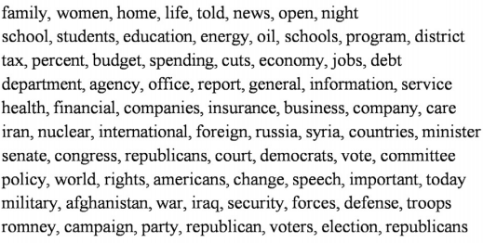
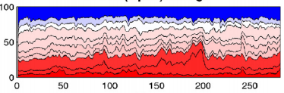
Topic Modeling
Sample results of topic modeling on News paper searched by ‘Obama’
What we can identify are
  Topics
  The proportion of topics
  The most probable words in topics
Text analysis without reading the whole corpus
Days

Slide 5
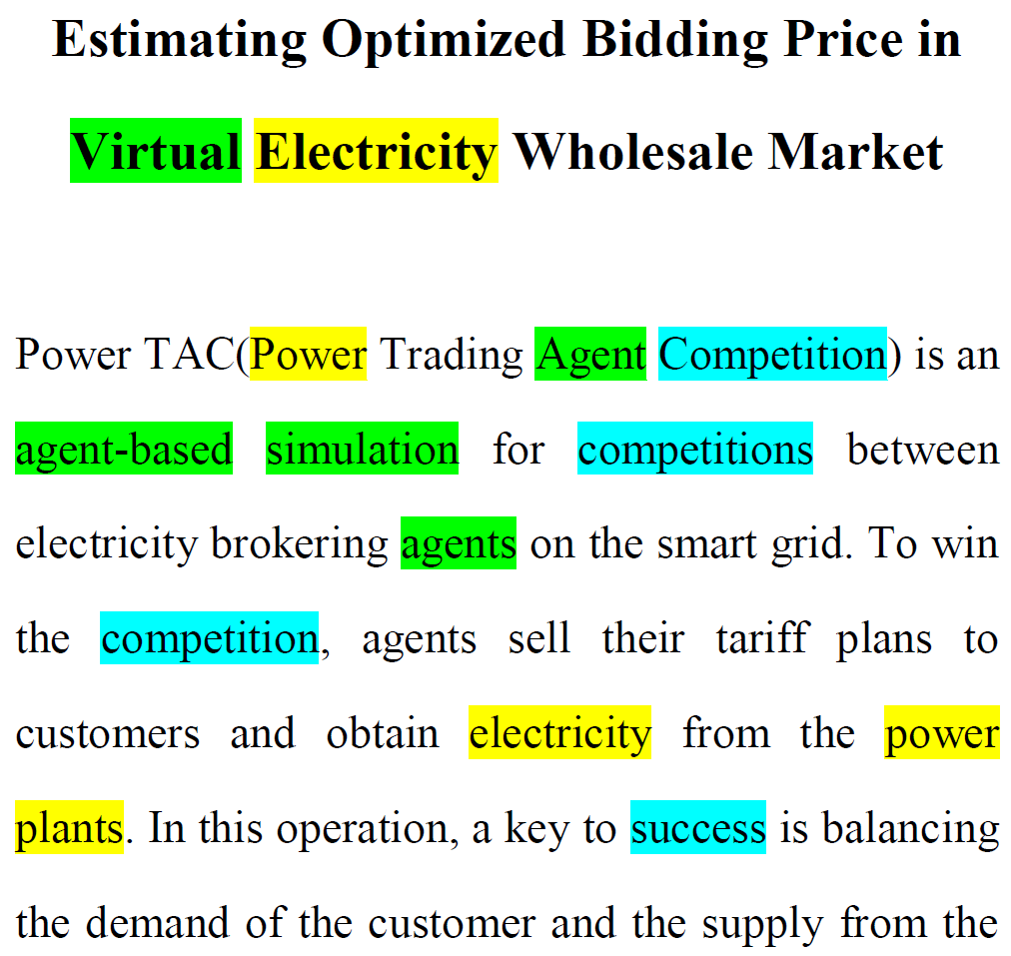
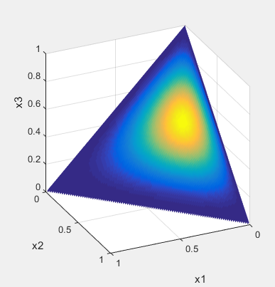






Latent Dirichlet Allocation
Latent Dirichlet Allocation
  Soft clustering in text data
  Has the structure of text corpus
  Is a Bayesian model with priors
For each word $w$, sample
topic assignment $z$
$$α$$
$$θ$$
z
w
$$φ$$
$$β$$
N
M
K
Prob.
Topic 1 2 3 $⋯$
Dirichlet Distribution
Prior
Document specific
topic proportion
Topic assignment
Notes:
We shall begin by discussing Bayesian networks, also known as directed graphical models, in which the links of the graphs have a particular directionality indicated by arrows. The other major class of graphical models are Markov random fields, also known as undirected graphical models, in which the links do not carry arrows and have no directional significance.

Slide 6

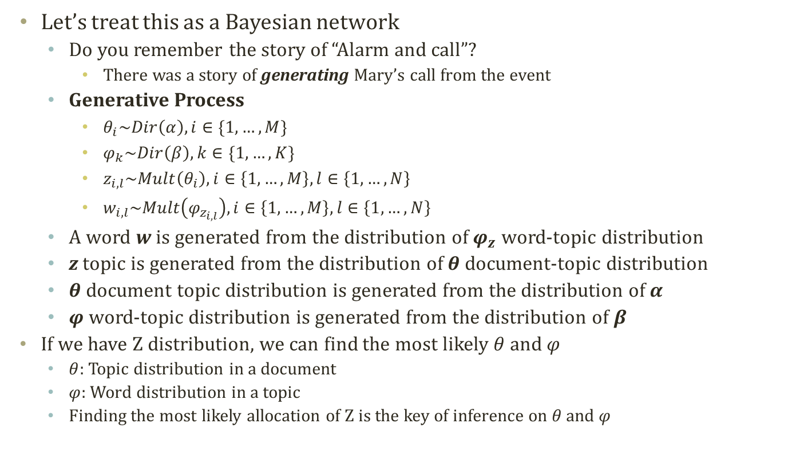



Finding Topic Assignment
Per Word
$$α$$
$$θ$$
z
w
$$φ$$
$$β$$
N
M
K
Let’s treat this as a Bayesian network
  Do you remember the story of “Alarm and call”?
    There was a story of generating Mary’s call from the event
  Generative Process
    $θ_{i}\sim Dir\left(α\right),i∈\{1,…,M\}$
    $φ_{k}\sim Dir\left(β\right),k∈\{1,…,K\}$
    $z_{i,l}\sim Mult\left(θ_{i}\right),i∈\left\{1,…,M\right\},l∈\left\{1,…,N\right\}$
    $w_{i,l}\sim Mult\left(φ_{z_{i,l}}\right),i∈\left\{1,…,M\right\},l∈\left\{1,…,N\right\}$
  A word w is generated from the distribution of $φ_{z}$ word-topic distribution
  z topic is generated from the distribution of $θ$ document-topic distribution
  $θ$ document topic distribution is generated from the distribution of $α$
  $φ$ word-topic distribution is generated from the distribution of $β$
If we have Z distribution, we can find the most likely $θ$ and $φ$
  $θ$: Topic distribution in a document
  $φ$: Word distribution in a topic
  Finding the most likely allocation of Z is the key of inference on $θ$ and $φ$

Slide 7

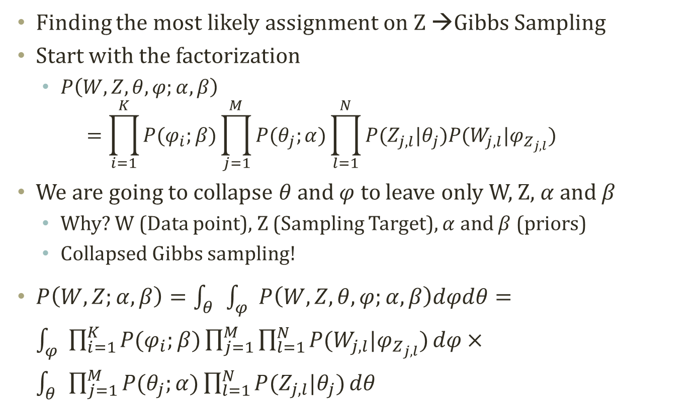



Gibbs Sampling on Z (1)
$$α$$
$$θ$$
z
w
$$φ$$
$$β$$
N
M
K
Finding the most likely assignment on Z →Gibbs Sampling
Start with the factorization
  $P\left(W,Z,θ,φ;α,β\right)$
  $=\prod_{i=1}^{K}{P(φ_{i};β)}\prod_{j=1}^{M}{P(θ_{j};α)\prod_{l=1}^{N}{P(Z_{j,l}|θ_{j})P(W_{j,l}|φ_{Z_{j,l}})}}$
We are going to collapse $θ$ and $φ$ to leave only W, Z, $α$ and $β$
  Why? W (Data point), Z (Sampling Target), $α$ and $β$ (priors)
  Collapsed Gibbs sampling!
$P\left(W,Z;α,β\right)=\int_{θ}{\int_{φ}{P\left(W,Z,θ,φ;α,β\right)dφdθ}}=\int_{φ}{\prod_{i=1}^{K}{P(φ_{i};β)\prod_{j=1}^{M}{\prod_{l=1}^{N}{P(W_{j,l}|φ_{Z_{j,l}})}}dφ}}×\int_{θ}{\prod_{j=1}^{M}{P(θ_{j};α)\prod_{l=1}^{N}{P(Z_{j,l}|θ_{j})}}dθ}$
Independence between two integrals
Need to remove the integrals and come up with the sampling distribution
© Wikipedia page on LDA

Slide 8

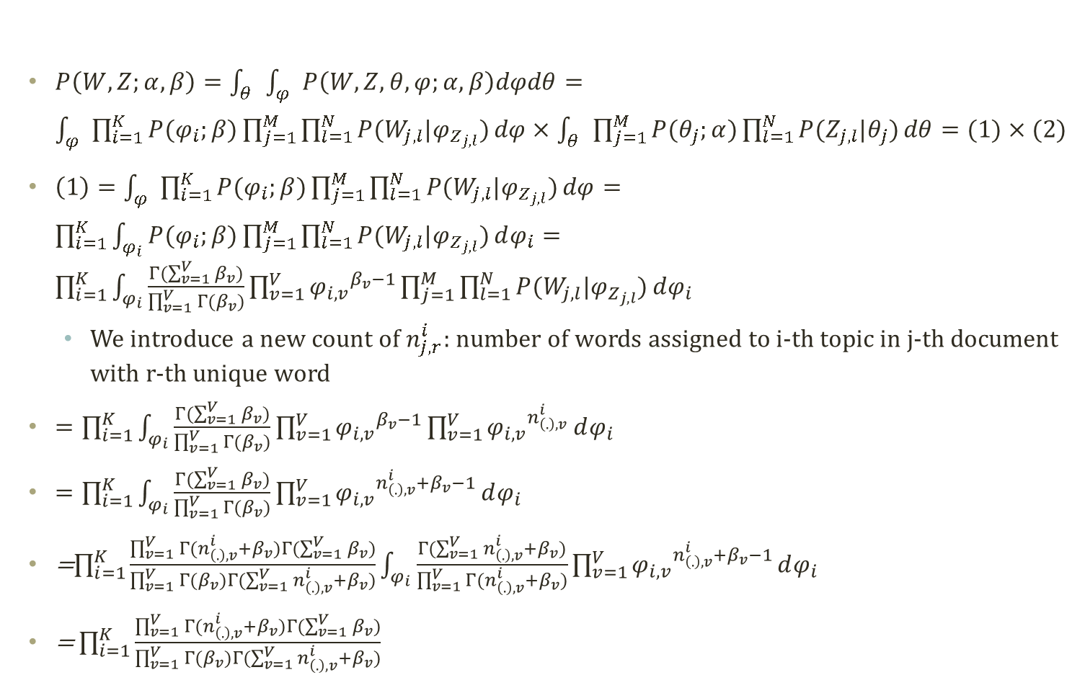
Gibbs Sampling on Z (2)
$$x\sim Dir\left(α\right)$$
$$P\left(X | α\right)=\frac{Γ(\sum_{i=1}^{K}{α_{i}})}{\prod_{i=1}^{K}{{Γ(α}_{i})}}\prod_{i=1}^{K}{{x_{i}}^{α_{i}−1}}$$
$P\left(W,Z;α,β\right)=\int_{θ}{\int_{φ}{P\left(W,Z,θ,φ;α,β\right)dφdθ}}=\int_{φ}{\prod_{i=1}^{K}{P(φ_{i};β)\prod_{j=1}^{M}{\prod_{l=1}^{N}{P(W_{j,l}|φ_{Z_{j,l}})}}dφ}}×\int_{θ}{\prod_{j=1}^{M}{P(θ_{j};α)\prod_{l=1}^{N}{P(Z_{j,l}|θ_{j})}}dθ}=(1)×(2)$
$\left(1\right)=\int_{φ}{\prod_{i=1}^{K}{P(φ_{i};β)\prod_{j=1}^{M}{\prod_{l=1}^{N}{P(W_{j,l}|φ_{Z_{j,l}})}}dφ}}=\prod_{i=1}^{K}{\int_{φ_{i}}{P(φ_{i};β)\prod_{j=1}^{M}{\prod_{l=1}^{N}{P(W_{j,l}|φ_{Z_{j,l}})}}}dφ_{i}}=\prod_{i=1}^{K}{\int_{φ_{i}}{\frac{Γ(\sum_{v=1}^{V}{β_{v}})}{\prod_{v=1}^{V}{{Γ(β}_{v})}}\prod_{v=1}^{V}{{φ_{i,v}}^{β_{v}−1}}\prod_{j=1}^{M}{\prod_{l=1}^{N}{P(W_{j,l}|φ_{Z_{j,l}})}}}dφ_{i}}$
  We introduce a new count of $n_{j,r}^{i}$: number of words assigned to i-th topic in j-th document with r-th unique word
$=\prod_{i=1}^{K}{\int_{φ_{i}}{\frac{Γ(\sum_{v=1}^{V}{β_{v}})}{\prod_{v=1}^{V}{{Γ(β}_{v})}}\prod_{v=1}^{V}{{φ_{i,v}}^{β_{v}−1}}\prod_{v=1}^{V}{{φ_{i,v}}^{n_{\left(.\right),v}^{i}}}}dφ_{i}}$
$=\prod_{i=1}^{K}{\int_{φ_{i}}{\frac{Γ(\sum_{v=1}^{V}{β_{v}})}{\prod_{v=1}^{V}{{Γ(β}_{v})}}\prod_{v=1}^{V}{{φ_{i,v}}^{n_{\left(.\right),v}^{i}+β_{v}−1}}}dφ_{i}}$
=$\prod_{i=1}^{K}{\frac{\prod_{v=1}^{V}{Γ(n_{\left(.\right),v}^{i}+β_{v})}Γ(\sum_{v=1}^{V}{β_{v}})}{\prod_{v=1}^{V}{{Γ(β}_{v})}Γ(\sum_{v=1}^{V}{n_{\left(.\right),v}^{i}+β_{v}})}\int_{φ_{i}}{\frac{Γ(\sum_{v=1}^{V}{n_{\left(.\right),v}^{i}+β_{v}})}{\prod_{v=1}^{V}{Γ(n_{\left(.\right),v}^{i}+β_{v})}}\prod_{v=1}^{V}{{φ_{i,v}}^{n_{\left(.\right),v}^{i}+β_{v}−1}}}dφ_{i}}$
$\text{=}\prod_{i=1}^{K}{\frac{\prod_{v=1}^{V}{Γ(n_{\left(.\right),v}^{i}+β_{v})}Γ(\sum_{v=1}^{V}{β_{v}})}{\prod_{v=1}^{V}{{Γ(β}_{v})}Γ(\sum_{v=1}^{V}{n_{\left(.\right),v}^{i}+β_{v}})}}$
© Wikipedia page on LDA

Slide 9
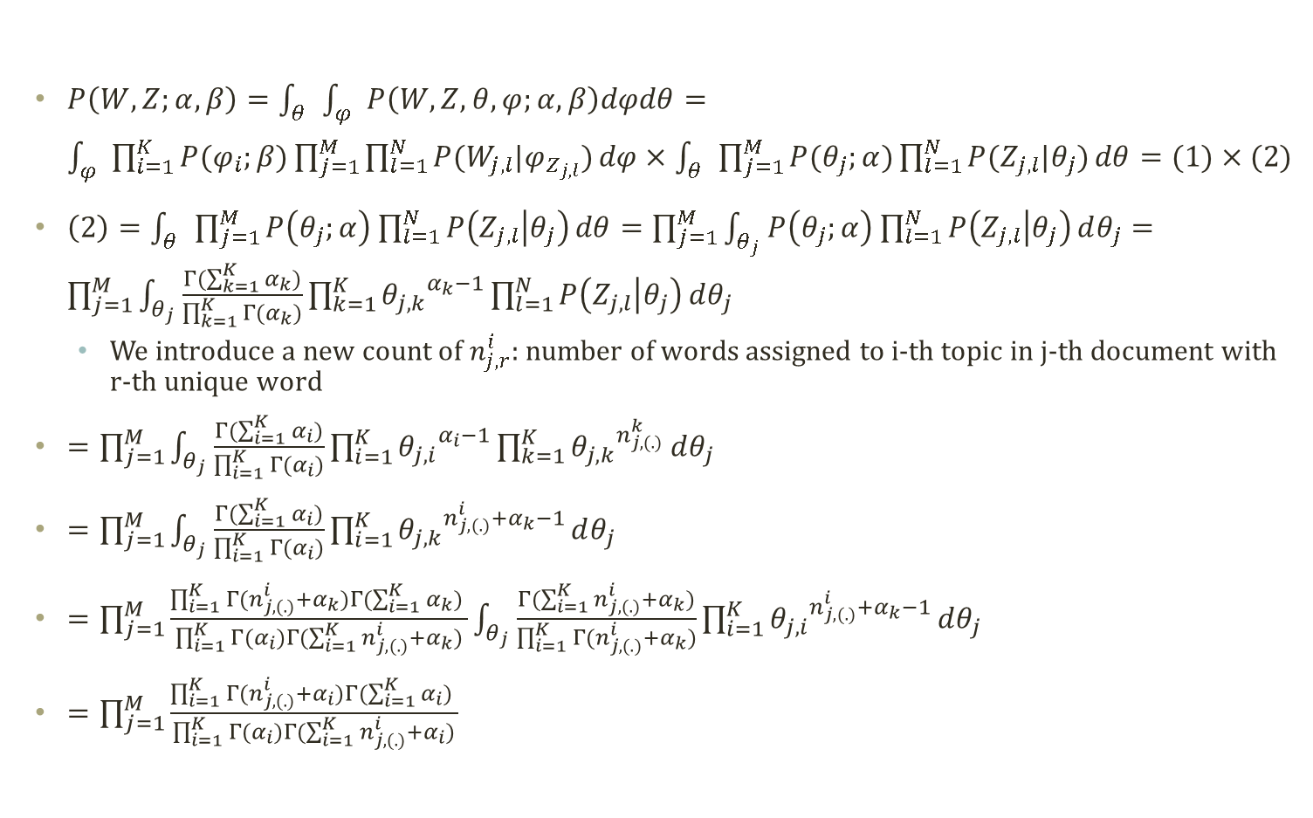
Gibbs Sampling on Z (3)
$$x\sim Dir\left(α\right)$$
$$P\left(X | α\right)=\frac{Γ(\sum_{i=1}^{K}{α_{i}})}{\prod_{i=1}^{K}{{Γ(α}_{i})}}\prod_{i=1}^{K}{{x_{i}}^{α_{i}−1}}$$
$P\left(W,Z;α,β\right)=\int_{θ}{\int_{φ}{P\left(W,Z,θ,φ;α,β\right)dφdθ}}=\int_{φ}{\prod_{i=1}^{K}{P(φ_{i};β)\prod_{j=1}^{M}{\prod_{l=1}^{N}{P(W_{j,l}|φ_{Z_{j,l}})}}dφ}}×\int_{θ}{\prod_{j=1}^{M}{P(θ_{j};α)\prod_{l=1}^{N}{P(Z_{j,l}|θ_{j})}}dθ}=(1)×(2)$
$\left(2\right)=\int_{θ}{\prod_{j=1}^{M}{P\left(θ_{j};α\right)\prod_{l=1}^{N}{P\left(Z_{j,l} | θ_{j}\right)}}dθ}=\prod_{j=1}^{M}{\int_{θ_{j}}{P\left(θ_{j};α\right)\prod_{l=1}^{N}{P\left(Z_{j,l} | θ_{j}\right)}dθ_{j}}}=\prod_{j=1}^{M}{\int_{θ_{j}}{\frac{Γ(\sum_{k=1}^{K}{α_{k}})}{\prod_{k=1}^{K}{{Γ(α}_{k})}}\prod_{k=1}^{K}{{θ_{j,k}}^{α_{k}−1}}\prod_{l=1}^{N}{P\left(Z_{j,l} | θ_{j}\right)}dθ_{j}}}$
  We introduce a new count of $n_{j,r}^{i}$: number of words assigned to i-th topic in j-th document with r-th unique word
$=\prod_{j=1}^{M}{\int_{θ_{j}}{\frac{Γ(\sum_{i=1}^{K}{α_{i}})}{\prod_{i=1}^{K}{{Γ(α}_{i})}}\prod_{i=1}^{K}{{θ_{j,i}}^{α_{i}−1}}\prod_{k=1}^{K}{{θ_{j,k}}^{n_{j,(.)}^{k}}}dθ_{j}}}$
$=\prod_{j=1}^{M}{\int_{θ_{j}}{\frac{Γ(\sum_{i=1}^{K}{α_{i}})}{\prod_{i=1}^{K}{{Γ(α}_{i})}}\prod_{i=1}^{K}{{θ_{j,k}}^{n_{j,(.)}^{i}+α_{k}−1}}dθ_{j}}}$
$=\prod_{j=1}^{M}{\frac{\prod_{i=1}^{K}{{Γ(n_{j,(.)}^{i}+α}_{k})}Γ(\sum_{i=1}^{K}{α_{k}}) }{\prod_{i=1}^{K}{{Γ(α}_{i})}Γ(\sum_{i=1}^{K}{n_{j,(.)}^{i}+α_{k}})}\int_{θ_{j}}{\frac{Γ(\sum_{i=1}^{K}{n_{j,(.)}^{i}+α_{k}})}{\prod_{i=1}^{K}{{Γ(n_{j,(.)}^{i}+α}_{k})}}\prod_{i=1}^{K}{{θ_{j,i}}^{n_{j,(.)}^{i}+α_{k}−1}}dθ_{j}}}$
$=\prod_{j=1}^{M}{\frac{\prod_{i=1}^{K}{{Γ(n_{j,(.)}^{i}+α}_{i})}Γ(\sum_{i=1}^{K}{α_{i}}) }{\prod_{i=1}^{K}{{Γ(α}_{i})}Γ(\sum_{i=1}^{K}{n_{j,(.)}^{i}+α_{i}})}}$
© Wikipedia page on LDA

Slide 10
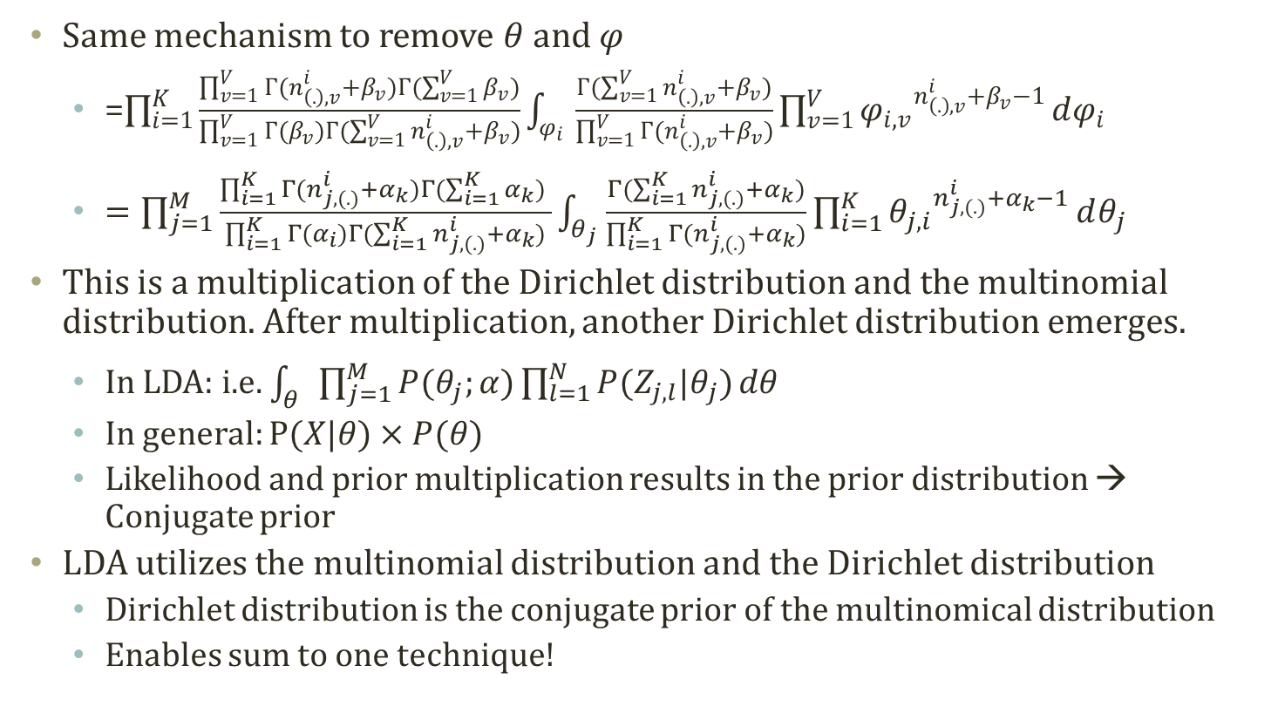
Collapse from Conjugacy
Same mechanism to remove $θ$ and $φ$
  =$\prod_{i=1}^{K}{\frac{\prod_{v=1}^{V}{Γ(n_{\left(.\right),v}^{i}+β_{v})}Γ(\sum_{v=1}^{V}{β_{v}})}{\prod_{v=1}^{V}{{Γ(β}_{v})}Γ(\sum_{v=1}^{V}{n_{\left(.\right),v}^{i}+β_{v}})}\int_{φ_{i}}{\frac{Γ(\sum_{v=1}^{V}{n_{\left(.\right),v}^{i}+β_{v}})}{\prod_{v=1}^{V}{Γ(n_{\left(.\right),v}^{i}+β_{v})}}\prod_{v=1}^{V}{{φ_{i,v}}^{n_{\left(.\right),v}^{i}+β_{v}−1}}}dφ_{i}}$
  $=\prod_{j=1}^{M}{\frac{\prod_{i=1}^{K}{{Γ(n_{j,(.)}^{i}+α}_{k})}Γ(\sum_{i=1}^{K}{α_{k}}) }{\prod_{i=1}^{K}{{Γ(α}_{i})}Γ(\sum_{i=1}^{K}{n_{j,(.)}^{i}+α_{k}})}\int_{θ_{j}}{\frac{Γ(\sum_{i=1}^{K}{n_{j,(.)}^{i}+α_{k}})}{\prod_{i=1}^{K}{{Γ(n_{j,(.)}^{i}+α}_{k})}}\prod_{i=1}^{K}{{θ_{j,i}}^{n_{j,(.)}^{i}+α_{k}−1}}dθ_{j}}}$
This is a multiplication of the Dirichlet distribution and the multinomial distribution. After multiplication, another Dirichlet distribution emerges.
  In LDA: i.e. $\int_{θ}{\prod_{j=1}^{M}{P(θ_{j};α)\prod_{l=1}^{N}{P(Z_{j,l}|θ_{j})}}dθ}$
  In general: $P(X|θ)×P(θ)$
  Likelihood and prior multiplication results in the prior distribution → Conjugate prior
LDA utilizes the multinomial distribution and the Dirichlet distribution
  Dirichlet distribution is the conjugate prior of the multinomical distribution
  Enables sum to one technique!

Slide 11

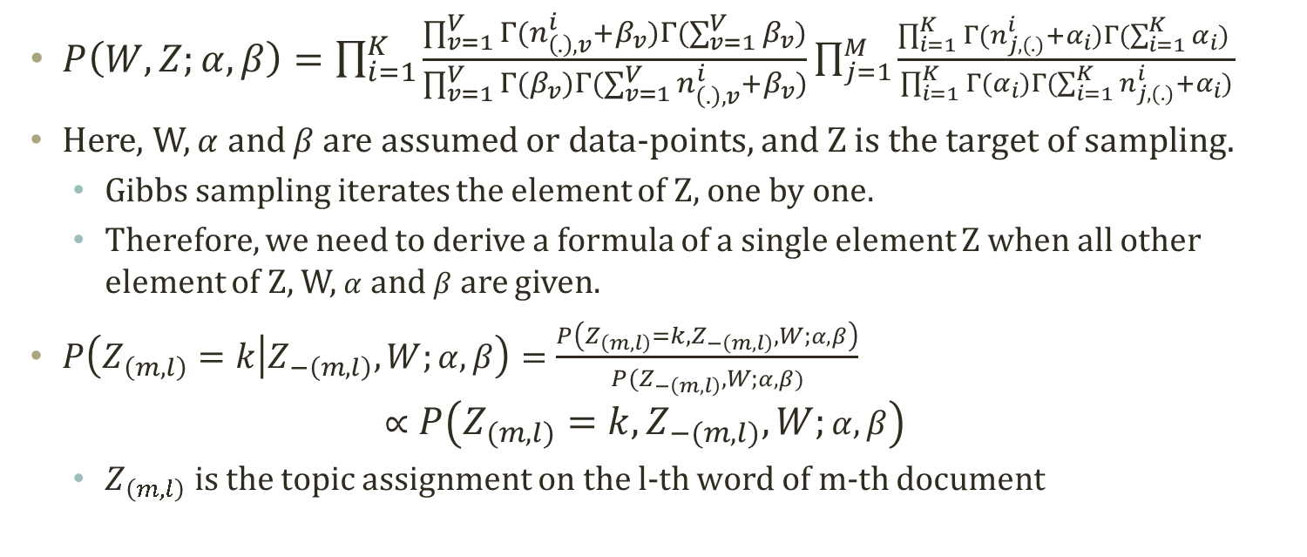



Gibbs Sampling Formula (1)
$P\left(W,Z;α,β\right)=\prod_{i=1}^{K}{\frac{\prod_{v=1}^{V}{Γ(n_{\left(.\right),v}^{i}+β_{v})}Γ(\sum_{v=1}^{V}{β_{v}})}{\prod_{v=1}^{V}{{Γ(β}_{v})}Γ(\sum_{v=1}^{V}{n_{\left(.\right),v}^{i}+β_{v}})}}\prod_{j=1}^{M}{\frac{\prod_{i=1}^{K}{{Γ(n_{j,(.)}^{i}+α}_{i})}Γ(\sum_{i=1}^{K}{α_{i}}) }{\prod_{i=1}^{K}{{Γ(α}_{i})}Γ(\sum_{i=1}^{K}{n_{j,(.)}^{i}+α_{i}})}}$
Here, W, $α$ and $β$ are assumed or data-points, and Z is the target of sampling.
  Gibbs sampling iterates the element of Z, one by one.
  Therefore, we need to derive a formula of a single element Z when all other element of Z, W, $α$ and $β$ are given.
$P\left(Z_{\left(m,l\right)}=k | Z_{−\left(m,l\right)},W;α,β\right)=\frac{P\left(Z_{\left(m,l\right)}=k,Z_{−\left(m,l\right)},W;α,β\right)}{P(Z_{−\left(m,l\right)},W;α,β)}$
$∝P\left(Z_{\left(m,l\right)}=k,Z_{−\left(m,l\right)},W;α,β\right)$
  $Z_{\left(m,l\right)}$ is the topic assignment on the l-th word of m-th document
$$\left\{z_{1}^{\left(τ\right)},z_{2}^{\left(τ\right)},z_{3}^{\left(τ\right)}\right\}$$
$$\left\{z_{1}^{\left(τ+1\right)},z_{2}^{\left(τ\right)},z_{3}^{\left(τ\right)}\right\}$$
$$\left\{z_{1}^{\left(τ+1\right)},z_{2}^{\left(τ+1\right)},z_{3}^{\left(τ\right)}\right\}$$
$$\left\{z_{1}^{\left(τ+1\right)},z_{2}^{\left(τ+1\right)},z_{3}^{\left(τ+1\right)}\right\}$$

Slide 12
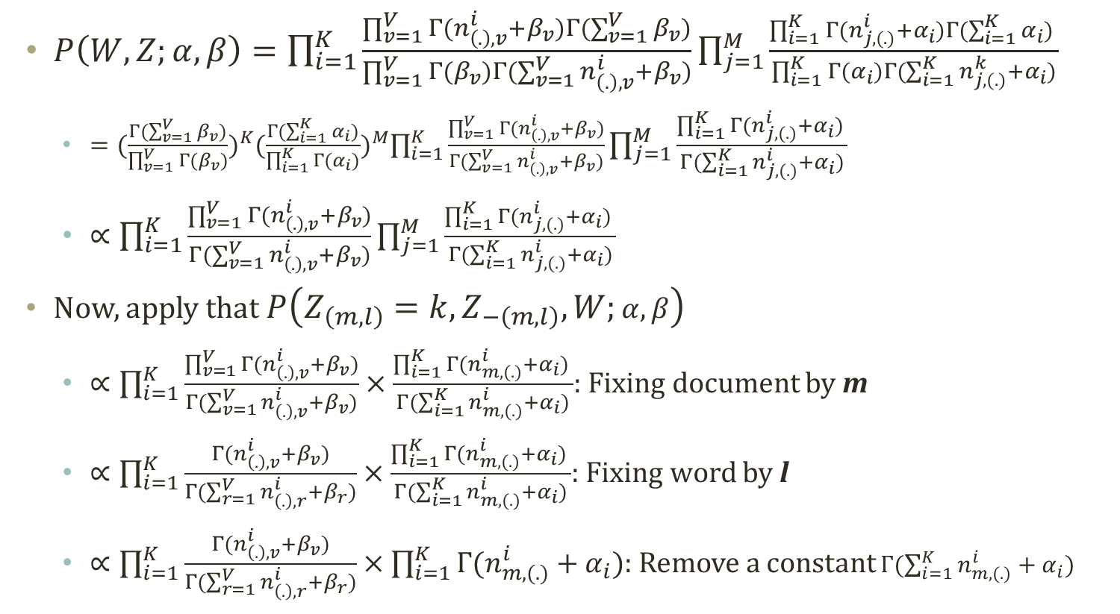
Gibbs Sampling Formula (2)
$P\left(W,Z;α,β\right)=\prod_{i=1}^{K}{\frac{\prod_{v=1}^{V}{Γ(n_{\left(.\right),v}^{i}+β_{v})}Γ(\sum_{v=1}^{V}{β_{v}})}{\prod_{v=1}^{V}{{Γ(β}_{v})}Γ(\sum_{v=1}^{V}{n_{\left(.\right),v}^{i}+β_{v}})}}\prod_{j=1}^{M}{\frac{\prod_{i=1}^{K}{{Γ(n_{j,(.)}^{i}+α}_{i})}Γ(\sum_{i=1}^{K}{α_{i}}) }{\prod_{i=1}^{K}{{Γ(α}_{i})}Γ(\sum_{i=1}^{K}{n_{j,(.)}^{k}+α_{i}})}}$
  $={(\frac{Γ(\sum_{v=1}^{V}{β_{v}})}{\prod_{v=1}^{V}{{Γ(β}_{v})}})}^{K}{(\frac{Γ(\sum_{i=1}^{K}{α_{i}})}{\prod_{i=1}^{K}{{Γ(α}_{i})}})}^{M}\prod_{i=1}^{K}{\frac{\prod_{v=1}^{V}{Γ(n_{\left(.\right),v}^{i}+β_{v})}}{Γ(\sum_{v=1}^{V}{n_{\left(.\right),v}^{i}+β_{v}})}}\prod_{j=1}^{M}{\frac{\prod_{i=1}^{K}{{Γ(n_{j,(.)}^{i}+α}_{i})} }{Γ(\sum_{i=1}^{K}{n_{j,(.)}^{i}+α_{i}})}}$
  $∝\prod_{i=1}^{K}{\frac{\prod_{v=1}^{V}{Γ(n_{\left(.\right),v}^{i}+β_{v})}}{Γ(\sum_{v=1}^{V}{n_{\left(.\right),v}^{i}+β_{v}})}}\prod_{j=1}^{M}{\frac{\prod_{i=1}^{K}{{Γ(n_{j,(.)}^{i}+α}_{i})} }{Γ(\sum_{i=1}^{K}{n_{j,(.)}^{i}+α_{i}})}}$
Now, apply that $P\left(Z_{\left(m,l\right)}=k,Z_{−\left(m,l\right)},W;α,β\right)$
  $∝\prod_{i=1}^{K}{\frac{\prod_{v=1}^{V}{Γ(n_{\left(.\right),v}^{i}+β_{v})}}{Γ(\sum_{v=1}^{V}{n_{\left(.\right),v}^{i}+β_{v}})}}×\frac{\prod_{i=1}^{K}{{Γ(n_{m,(.)}^{i}+α}_{i})} }{Γ(\sum_{i=1}^{K}{n_{m,(.)}^{i}+α_{i}})}$: Fixing document by m
  $∝\prod_{i=1}^{K}{\frac{Γ(n_{\left(.\right),v}^{i}+β_{v})}{Γ(\sum_{r=1}^{V}{n_{\left(.\right),r}^{i}+β_{r}})}}×\frac{\prod_{i=1}^{K}{{Γ(n_{m,(.)}^{i}+α}_{i})} }{Γ(\sum_{i=1}^{K}{n_{m,(.)}^{i}+α_{i}})}$: Fixing word by l
  $∝\prod_{i=1}^{K}{\frac{Γ(n_{\left(.\right),v}^{i}+β_{v})}{Γ(\sum_{r=1}^{V}{n_{\left(.\right),r}^{i}+β_{r}})}}×\prod_{i=1}^{K}{{Γ(n_{m,(.)}^{i}+α}_{i})}$: Remove a constant $Γ(\sum_{i=1}^{K}{n_{m,(.)}^{i}+α_{i}})$

Slide 13
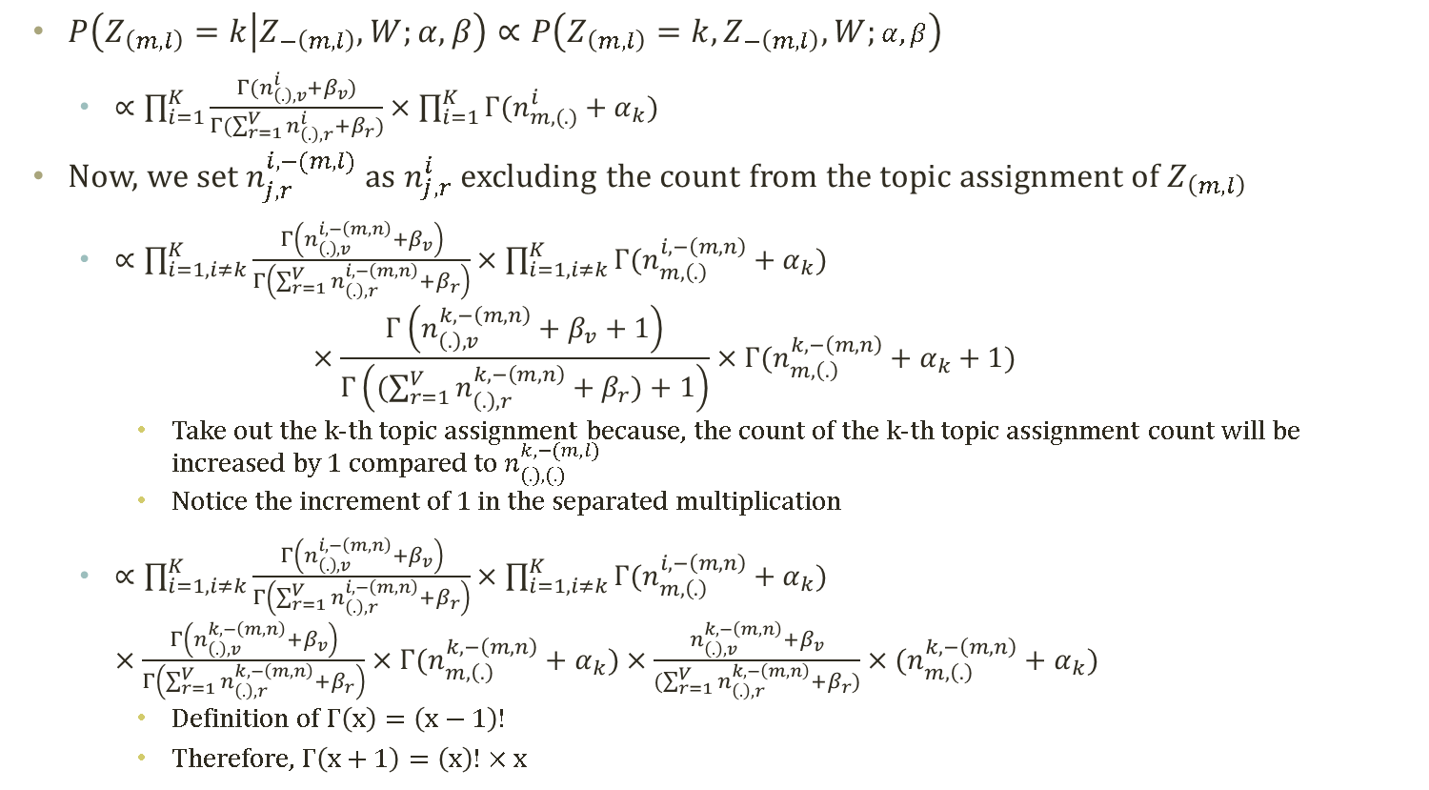
Gibbs Sampling Formula (3)
$P\left(Z_{\left(m,l\right)}=k | Z_{−\left(m,l\right)},W;α,β\right)∝P\left(Z_{\left(m,l\right)}=k,Z_{−\left(m,l\right)},W;α,β\right)$
  $∝\prod_{i=1}^{K}{\frac{Γ(n_{\left(.\right),v}^{i}+β_{v})}{Γ(\sum_{r=1}^{V}{n_{\left(.\right),r}^{i}+β_{r}})}}×\prod_{i=1}^{K}{{Γ(n_{m,(.)}^{i}+α}_{k})}$
Now, we set $n_{j,r}^{i,−(m,l)}$ as $n_{j,r}^{i}$ excluding the count from the topic assignment of $Z_{\left(m,l\right)}$
  $∝\prod_{i=1,i≠k}^{K}{\frac{Γ\left(n_{\left(.\right),v}^{i,−\left(m,n\right)}+β_{v}\right)}{Γ\left(\sum_{r=1}^{V}{n_{\left(.\right),r}^{i,−\left(m,n\right)}+β_{r}}\right)}}×\prod_{i=1,i≠k}^{K}{{Γ(n_{m,\left(.\right)}^{i,−\left(m,n\right)}+α}_{k})}$
  $×\frac{Γ\left(n_{\left(.\right),v}^{k,−\left(m,n\right)}+β_{v}+1\right)}{Γ\left((\sum_{r=1}^{V}{n_{\left(.\right),r}^{k,−\left(m,n\right)}+β_{r}})+1\right)}×{Γ(n_{m,\left(.\right)}^{k,−\left(m,n\right)}+α}_{k}+1)$
    Take out the k-th topic assignment because, the count of the k-th topic assignment count will be increased by 1 compared to $n_{(.),(.)}^{k,−(m,l)}$
    Notice the increment of 1 in the separated multiplication
  $∝\prod_{i=1,i≠k}^{K}{\frac{Γ\left(n_{\left(.\right),v}^{i,−\left(m,n\right)}+β_{v}\right)}{Γ\left(\sum_{r=1}^{V}{n_{\left(.\right),r}^{i,−\left(m,n\right)}+β_{r}}\right)}}×\prod_{i=1,i≠k}^{K}{{Γ(n_{m,\left(.\right)}^{i,−\left(m,n\right)}+α}_{k})}$
  $×\frac{Γ\left(n_{\left(.\right),v}^{k,−\left(m,n\right)}+β_{v}\right)}{Γ\left(\sum_{r=1}^{V}{n_{\left(.\right),r}^{k,−\left(m,n\right)}+β_{r}}\right)}×{Γ(n_{m,\left(.\right)}^{k,−\left(m,n\right)}+α}_{k})$ $×\frac{n_{\left(.\right),v}^{k,−\left(m,n\right)}+β_{v}}{(\sum_{r=1}^{V}{n_{\left(.\right),r}^{k,−\left(m,n\right)}+β_{r}})}×{(n_{m,\left(.\right)}^{k,−\left(m,n\right)}+α}_{k})$
    Definition of $Γ\left(x\right)=\left(x−1\right)!$
    Therefore, $Γ\left(x+1\right)=\left(x\right)!×x$

Slide 14
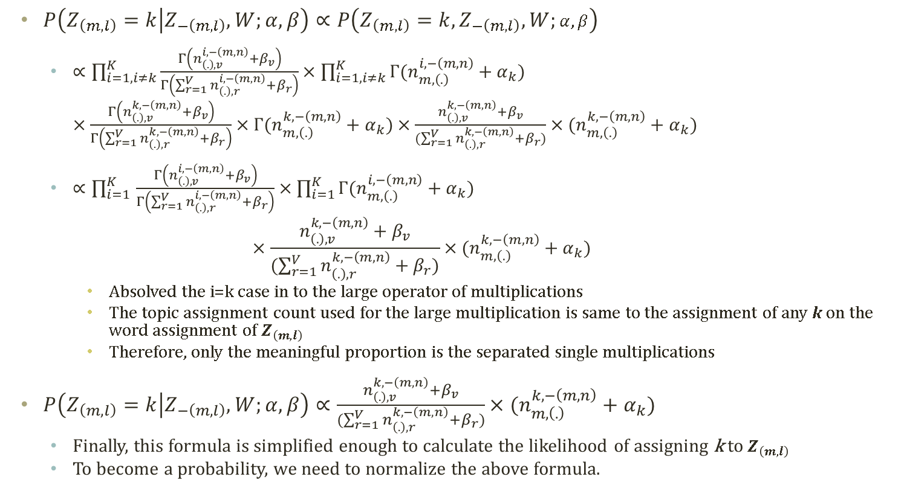
Gibbs Sampling Formula (4)
$P\left(Z_{\left(m,l\right)}=k | Z_{−\left(m,l\right)},W;α,β\right)∝P\left(Z_{\left(m,l\right)}=k,Z_{−\left(m,l\right)},W;α,β\right)$
  $∝\prod_{i=1,i≠k}^{K}{\frac{Γ\left(n_{\left(.\right),v}^{i,−\left(m,n\right)}+β_{v}\right)}{Γ\left(\sum_{r=1}^{V}{n_{\left(.\right),r}^{i,−\left(m,n\right)}+β_{r}}\right)}}×\prod_{i=1,i≠k}^{K}{{Γ(n_{m,\left(.\right)}^{i,−\left(m,n\right)}+α}_{k})}$
  $×\frac{Γ\left(n_{\left(.\right),v}^{k,−\left(m,n\right)}+β_{v}\right)}{Γ\left(\sum_{r=1}^{V}{n_{\left(.\right),r}^{k,−\left(m,n\right)}+β_{r}}\right)}×{Γ(n_{m,\left(.\right)}^{k,−\left(m,n\right)}+α}_{k})$ $×\frac{n_{\left(.\right),v}^{k,−\left(m,n\right)}+β_{v}}{(\sum_{r=1}^{V}{n_{\left(.\right),r}^{k,−\left(m,n\right)}+β_{r}})}×{(n_{m,\left(.\right)}^{k,−\left(m,n\right)}+α}_{k})$
  $∝\prod_{i=1 }^{K}{\frac{Γ\left(n_{\left(.\right),v}^{i,−\left(m,n\right)}+β_{v}\right)}{Γ\left(\sum_{r=1}^{V}{n_{\left(.\right),r}^{i,−\left(m,n\right)}+β_{r}}\right)}}×\prod_{i=1}^{K}{{Γ(n_{m,\left(.\right)}^{i,−\left(m,n\right)}+α}_{k})}$
  $×\frac{n_{\left(.\right),v}^{k,−\left(m,n\right)}+β_{v}}{(\sum_{r=1}^{V}{n_{\left(.\right),r}^{k,−\left(m,n\right)}+β_{r}})}×{(n_{m,\left(.\right)}^{k,−\left(m,n\right)}+α}_{k})$
    Absolved the i=k case in to the large operator of multiplications
    The topic assignment count used for the large multiplication is same to the assignment of any k on the word assignment of $Z_{\left(m,l\right)}$
    Therefore, only the meaningful proportion is the separated single multiplications
$P\left(Z_{\left(m,l\right)}=k | Z_{−\left(m,l\right)},W;α,β\right)∝\frac{n_{\left(.\right),v}^{k,−\left(m,n\right)}+β_{v}}{(\sum_{r=1}^{V}{n_{\left(.\right),r}^{k,−\left(m,n\right)}+β_{r}})}×{(n_{m,\left(.\right)}^{k,−\left(m,n\right)}+α}_{k})$
  Finally, this formula is simplified enough to calculate the likelihood of assigning k to $Z_{\left(m,l\right)}$
  To become a probability, we need to normalize the above formula.

Slide 15
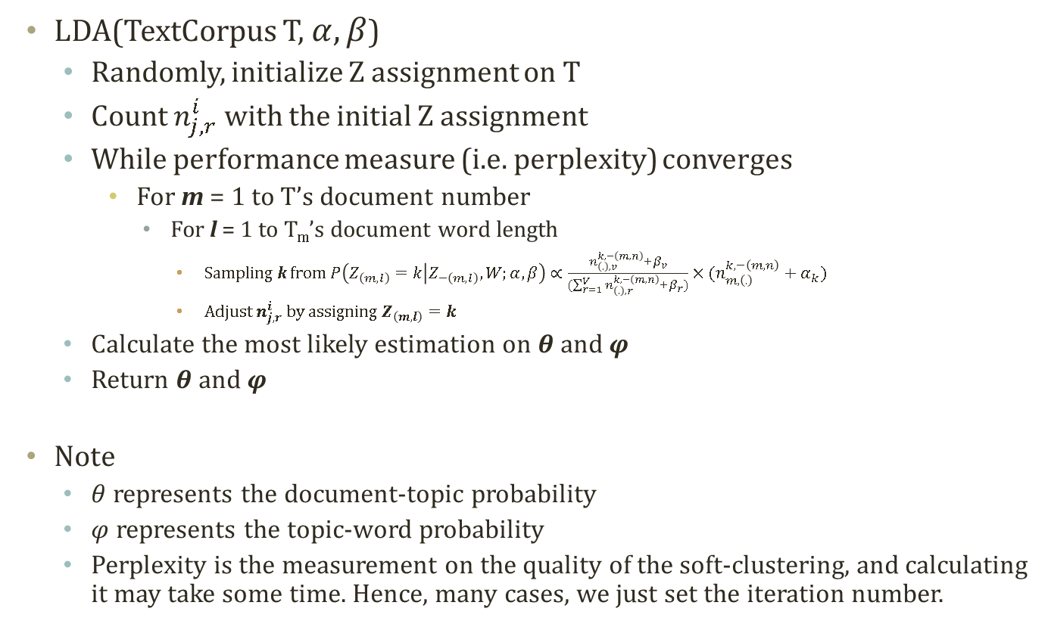
LDA Model Parameter Inference Routine with Gibbs
LDA(TextCorpus T, $α,β$)
  Randomly, initialize Z assignment on T
  Count $n_{j,r}^{i}$ with the initial Z assignment
  While performance measure (i.e. perplexity) converges
    For m = 1 to T’s document number
      For l = 1 to T_{m}’s document word length
        Sampling k from $P\left(Z_{\left(m,l\right)}=k | Z_{−\left(m,l\right)},W;α,β\right)∝\frac{n_{\left(.\right),v}^{k,−\left(m,n\right)}+β_{v}}{(\sum_{r=1}^{V}{n_{\left(.\right),r}^{k,−\left(m,n\right)}+β_{r}})}×{(n_{m,\left(.\right)}^{k,−\left(m,n\right)}+α}_{k})$
        Adjust $n_{j,r}^{i}$ by assigning $Z_{\left(m,l\right)}=k$
  Calculate the most likely estimation on $θ$ and $φ$
  Return $θ$ and $φ$
Note
  $θ$ represents the document-topic probability
  $φ$ represents the topic-word probability
  Perplexity is the measurement on the quality of the soft-clustering, and calculating it may take some time. Hence, many cases, we just set the iteration number.

